Slide 1
Types of Business Organizations
Economics
J. Gregory
(Adapted from Carlong Economics for CSEC)

Slide 2
Business Sector
Businesses operate either in
The public sector
The private sector
The private sector includes all firms owned by private individuals.
The public sector includes all government owned entities.

Slide 3
The Private Sector

Slide 4
Private Sector Organizations
Sole trader/proprietorship
Partnerships
Cooperatives
Private companies
Public companies

Slide 5
Sole Trader/Proprietorship
ADVANTAGES
Easy to form with small amount of start up capital required
Owner has personal control over the direction of his business
Personal contact maintained with staff and customers
Profits not shared
Owner enjoys the privilege and flexibility of being the sole decision maker
Business and wealth generated can be kept in the family

Slide 6
Sole Trader/Proprietorship
DISADVANTAGES
Limited capital and ability to expand
Unlimited liability
Lack of continuity
Owner bears all the losses
Long working hours

Slide 7
Partnership
A partnership is a business with two to twenty partners who pool their money and their resources with the aim of operating a business and making a profit.
Law firms and architectural companies often operate as partnerships.

Slide 8
Partnership
Types of Partnerships:
Ordinary: consists of active and silent partners all with unlimited liability
Limited: consists of active and silent partners with varying liability (Note: At least one partner must be active with unlimited liability.)
Active: actively involved in the day to day running of the business
Silent/Dormant/Sleeping : not actively involved in the day to day running of the business

Slide 9
Partnership
Unlimited liability means that “in the event of bankruptcy the partner would be responsible for all the unsecured debts of the firm. If the partner cannot pay the debts then his or her personal assets will be used to make the payment.” (Robinson and Cooke, 2011)
“Limited liability means that in the event of bankruptcy the partners would lose only what they invested in the business and their personal assets would not be used.” (Robinson and Cooke, 2011)

Slide 10
Partnership
ADVANTAGES:
More money is available to the business because partners may combine their resources
Partners bring their expertise to the business and can specialize in what they do best
All decisions and resulting responsibilities are shared
Workload can be shared making it possible for individual partners to take vacation
Not required by law to publish financial statements
Great incentive to succeed because of the personal investment that is at risk

Slide 11
Partnership
DISADVANTAGES:
At least one partner must bear the responsibility of unlimited liability
Partners may make errors that affect all members
Lack of continuity – if a partner leaves or dies, the partnership dissolves and this may create financial difficulties for the remaining partners (the business and the individual are not considered separate)
Limited capital; as the options for sourcing capital are few (Other types of businesses such as joint stock companies are able to raise far more capital than partnerships.)

Slide 12
Joint Stock Companies
Joint stock companies (or limited liability companies as they are also called) are companies owned by shareholders who invest in these companies with the hope of making a profit.

Slide 13
Joint Stock Companies
Business jointly owned by a number of individuals
Liability of owners limited to the amount of shares bought
The business is separate from the owners
The business is legally required to publish specific information about its operations

Slide 14
Joint Stock Companies
Types:
Private Limited – shares owned only by a few friends/relatives
Private Unlimited – owners have unlimited liability ( not very popular)
Public Limited – shares owned by members of the general public
Note: A public limited company is still considered a part of the private sector

Slide 15

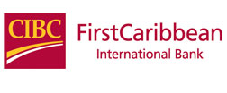
Joint Stock Companies
Regional Examples:
LIAT, official name LIAT 1974 Ltd. – Private limited company with the major shareholders being 11 Caribbean governments including the government of Antigua and Barbuda. (For a complete list of shareholders see: http://www.liatairline.com/navSource.html?page_id=80)
CIBC First Caribbean International Bank –Public limited company. In 2006, CIBC acquired FCIB by becoming the majority shareholder through purchase of shares owned by Barclays Bank.
Video Link: http://www.youtube.com/watch?v=GnJCOof2HJk

Slide 16
Joint Stock Companies
Shareholders are owners of the company and receive a share or portion of the profits in the form of dividends
Ordinary shareholders are paid in proportion to profits earned and have voting rights while Preference shareholders are a paid a fixed rate of return, are paid before ordinary shareholders but have no voting rights
Shareholders do not interfere in the day to day operations of the company but give that responsibility to the board of directors they elected every year.

Slide 17
Joint Stock Companies
ADVANTAGES:
Owners enjoy limited liability
Company taxed separately from owners
No restriction on transfer of shares (although this does not apply to a private company)
The stock exchange can be used to obtain additional funding if the are listed on the exchange
There is continuity of the business, therefore any change in ownership does not affect the life of the business

Slide 18
Joint Stock Companies
DISADVANTAGES
Legal formalities necessary to start a company are complicated and costly
The business may be impersonal as there may be little contact between employers and employees
Shareholders often do not have much say in the policy decisions of the company
Limited companies must hold an Annual General Meeting
Company profits are taxed twice: companies pay corporation taxes and shareholders pay taxes on dividends

Slide 19
Multinationals
Multinational companies are firms operating in more than one country. Usually, their headquarters or parent company is located in a developed country but they have many branches or subsidiaries in other parts of the world.

Slide 20



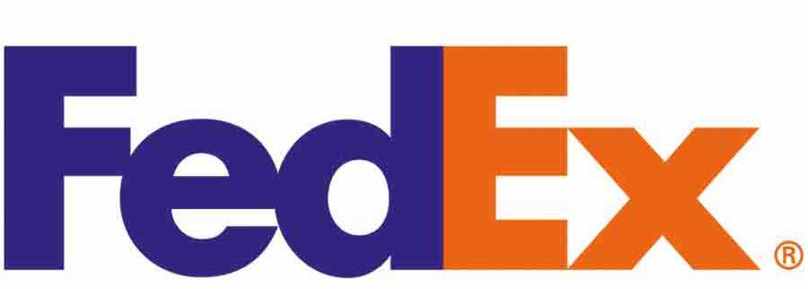
Multinationals
Companies are very large
Are public companies
Many owned by Japanese or United States Nationals
Examples:
Fed-Ex, KPMG, Royal Bank of Canada, Scotia Bank

Slide 21
Multinationals
ADVANTAGES:
They sell far more products to far more customers because of their presence in several countries
Low transportation costs because goods are produced in or close to local markets
Can take advantage of different wage levels in different countries, moving production to countries with the cheapest labour
They can achieve great economies of scale

Slide 22
Multinationals
ADVANTAGES continued:
Because they usually produce a wide variety of goods, they are less vulnerable to a fall in demand for one particular good
They can afford to carry out better quality research and development than other firms in order to improve old products and develop new ones
To provide employment and training opportunities to host countries

Slide 23
Multinationals
DISADVANTAGES:
They may relocate at anytime resulting in loss of employment in their host country
If a country has a poor tax or legal framework as in the case of many developing countries, multinationals may transfer their profits from one country to another to avoid paying taxes
Because of their large size and wealth, they may cause smaller firms in the host country to go bankrupt
Some of these companies may exploit workers in developing countries where labour is cheap

Slide 24
Cooperatives
A cooperative is a type of private business that is owned and controlled by a group of people who have a common interest and have equal say in decision making.
Cooperatives aim to provide benefits to all members in the form of lower prices, lower interest rates and employment for members

Slide 25
Cooperatives
TYPES:
Agricultural/producer – members pool resources to buy equipment and raw materials, share in decision making and profits
Consumers’/retail – goods are bought in bulk and resold to members just to cover the cost of the goods
Workers’ – owned by workers who all have an equal say in the running of the business and can therefore influence its operations
Financial – members pool their resources together from which they receive loans and other financial services
Service – provide members with services such as health care, housing, transportation and recreation

Slide 26

Cooperatives
EXAMPLES:
Financial: St Johns Cooperative Credit Union Ltd, Community First Cooperative Credit Union Ltd
Agricultural: Antigua-Barbuda Beekeepers Cooperative Society Ltd, Antigua Lettuce Farmers Cooperative, Barbuda Fishermen Cooperative Society
Video Links: http://www.youtube.com/watch?v=74gPFEqazMY
http://www.youtube.com/watch?v=gyWyjg6a3XM

Slide 27
Cooperatives
ADVANTAGES
Members have equal say in the running of the business
There are little or no advertising costs as members are committed to the business and give their support
Members of workers cooperatives benefit from employment
In some CARICOM countries, interest from savings is not taxed
The welfare of members takes precedence over profit making

Slide 28
Cooperatives
DISADVANTAGES
Shortage of capital may inhibit growth and create other problems
Managers may lack the skills to manage successfully
Conflicts may result when members are both employers and employees
Profits may be small or non-existent

Slide 29
The Public Sector

Slide 30
The Public Sector
“ Public sector businesses are those owned and controlled by the government. These firms may be owned by government from the start, or the government may take over a private firm through nationalization.” (Robinson and Cooke, 2011)

Slide 31
The Government
The government can be divided into
Central government
Local government
Central government consists of publicly elected members of cabinet. Within the cabinet, the Prime Minister appoints individuals to lead government departments called ministries.

Slide 32
The Government
Local government consists of individuals elected by the local communities in which they live.
Powers, duties and functions are defined by an Act of Parliament
Comprised of a council headed by a chairman or mayor
Financed by central government grants

Slide 33
Public or State Corporations
A state corporation operates like a public company except that it is formed through an Act of Parliament and is owned and controlled by government.
The responsible government minister selects a Board of Directors
The corporation has a separate legal identity from the government
Financed from the sale of goods services to consumers and grants from central government

Slide 34

Public or State Corporations
Local examples:
Central Marketing Corporation (formed by the Central Marketing Corporation Act, 1974)
State Insurance Corporation (formed by the State Insurance Corporation Act, 1986)

